Slide 1
Linux Programming
Linux
Programming
II-UNIT

Slide 2
What s shel ?
What is shell ?
The shell is
operating
an interface between the user and the
system.
The shell is
also known as command line
interpreter. Since user can’t interact with the
kernel directly, shell will pass the command line
to the kernel for execution.

Slide 3
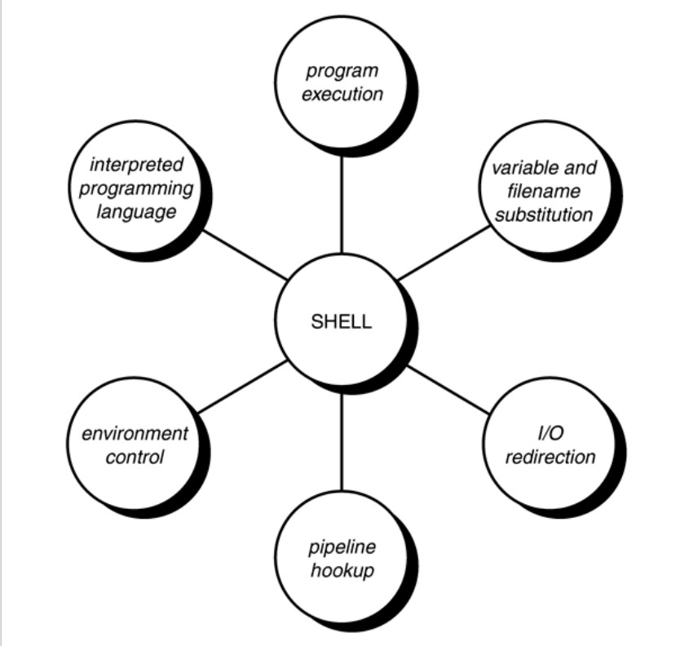
Shell Responsibili es
Shell Responsibilities

Slide 4
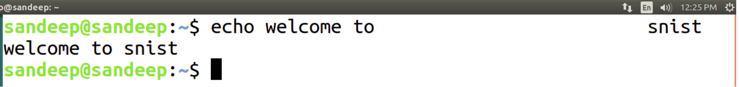
Program Execu ion
Program Execution
⎝
The shell is responsible for the execution of
from your terminal.
Each time you type in a line to the shell, the then determines what to do.
Each line follows the same basic format:
all programs that you request
⎝
shell analyzes the
line
and
⎝
Syntax : program-name arguments
Ex: ls -l
¬
The shell scans this command line and determines the name of the
program to be executed
multiple occurrences of
and what arguments to pass to the program.
whitespace characters are ignored by the shell. snist
¬
Ex : echo
welcome
to

Slide 5
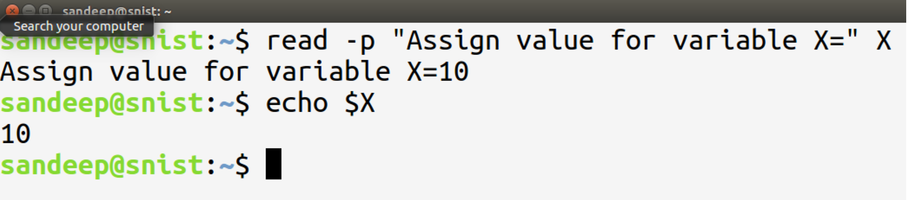
Var able and F lename Substitution
Variable and Filename Substitution
λ
Shell
Shell
Shell
lets you assign values to variables.
substitutes a variables whenever it is preceeded by $ sign performs file name substitution on command line
λ
λ
λ
shell scans the command line looking for filename substitution
characters *, ?, or [...] before determining the name of the program to execute and its arguments.
Example : variable name substitution

Slide 6
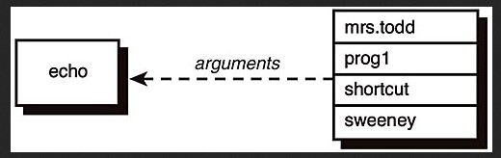
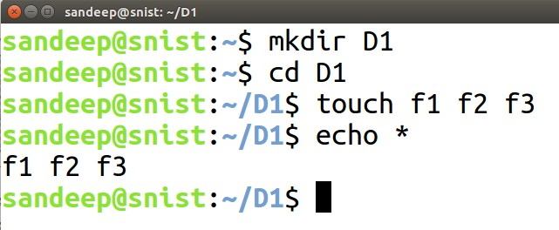
Variable and Filename Substitution
Example
: File name substitution
shell recognizes the special character * and substitutes on the command line
the names of all files in the current directory

Slide 7
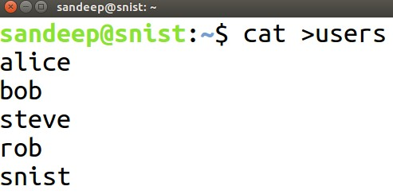
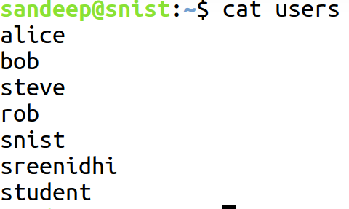
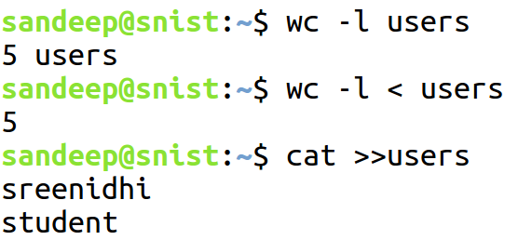
/O Redi ection
I/O Redirection
λ
It scans the command line for the occurrence of
the special redirection characters <, >, or >>

Slide 8
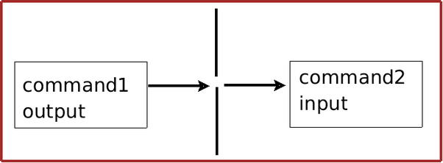
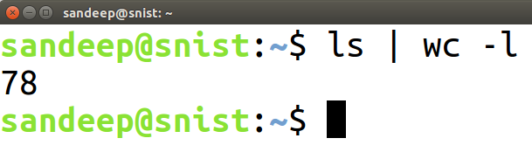
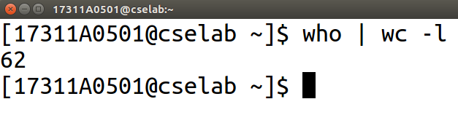
P peline Hookup
Pipeline Hookup
Shell connects the standard output from the command
preceding the | to the standard input of the one following the |. It then initiates execution of both programs.
Syntax: command_1 | command_2 [| command_3 . . . ]

Slide 9
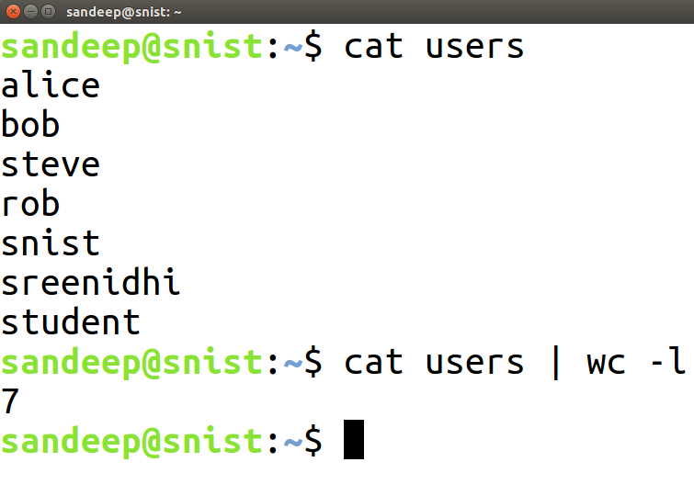
P peline Hookup
Pipeline Hookup
How to find the number of lines in a file?

Slide 10
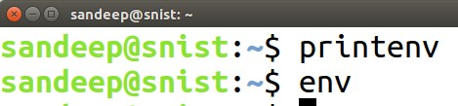
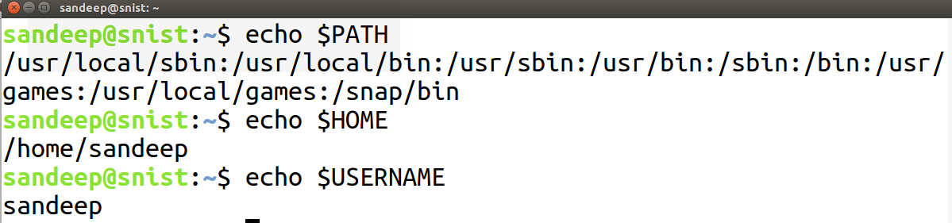
Environment Cont ol
Environment Control
An environment variable is a dynamic-named value that can affect the way running processes will behave on a computer. They are part of the environment in which a process runs
Give information about the system behavior

Slide 11
n erpreted Programming Language
Interpreted Programming Language
The shell has its own built-in programming language.
This language is interpreted, meaning that the shell
analyzes each statement in the language one line at
a time and then executes it.
This differs from programming languages such as C
and FORTRAN, in which the programming statements
are typically compiled into a machine executable form
before they are executed.

Slide 12
n erpreted Programming Language
Interpreted Programming Language
Easier to debug and modify than compiled ones.
Take much longer to execute than their compiled
equivalents.
Provides features like other programming languages.
looping constructs, decision-making statements,
variables, and functions, and is procedure-oriented.
Modern shells based on the IEEE POSIX standard
have many other features including arrays, data typing,
and built-in arithmetic operations.

Slide 13
Pipes And Input Redirection, Output Redirection
Pipes:
Standard output of one program used as standard input to next program
Used with filter commands to further refine data
Not limited to two programs

Slide 14
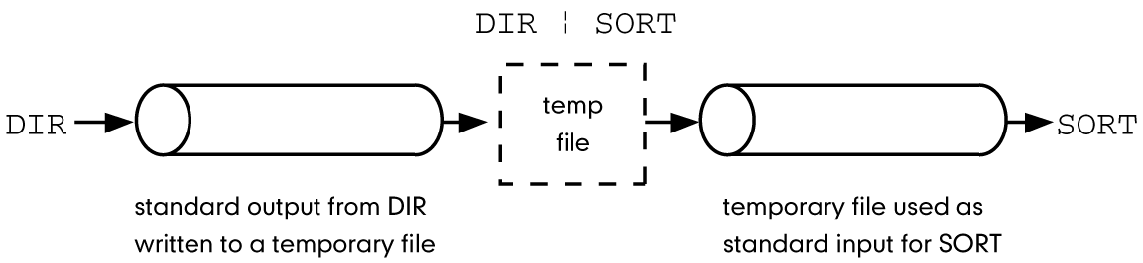
Pipe symbol is the vertical broken bar | and is used between two commands.

Slide 15
snist@snist-HP-280-G2-SFF:~/mamata$ who > f1.txt
snist@snist-HP-280-G2-SFF:~/mamata$ cat f1.txt
snist tty7 2017-12-27 14:41 (:0
Now use wc to make a complete count of this file contents, we use -l option to count the number of lines only
snist@snist-HP-280-G2-SFF:~/mamata$ wc -l < f1.txt
1
snist@snist-HP-280-G2-SFF:~/mamata$
Using intermediate file(f1.txt), we effectively counted the number of users.

Slide 16
This method of running two commands separately has two obvious disadvantages
For long running commands, this process can be slow. The second command cant act unless the first has completed its job
You need a intermediate file that has to be removed after completion of the job. When handling large files temporary files can build up easily and eat up disk space in no time
Here who’s standard output was redirected and so was wc’s standard input, and both used the same disk file.
The shell can connect these streams using a special operator | (pipe) and avoid creation of the disk file.
snist@snist-HP-280-G2-SFF:~/mamata$ who | wc -l
1

Slide 17
Here, the output of who has been passed directly to the input of wc. And who is said to be piped to wc .
You can know use one to count the number of files in the current directory
snist@snist-HP-280-G2-SFF:~/mamata$ ls | wc -l
3
snist@snist-HP-280-G2-SFF:~/mamata$
There is no restriction on the number of commands you can use in a pipeline. But you must know the behavioural properties of these commands to place them there.

Slide 18
Redirection-Input Redirection, Output Redirection
In the context of redirection, the terminal is a generic name that represents the screen, display or keyboard
We see command output and error messages on the terminal (display), and we sometimes provide command input through the terminal (keyboard)
The shell associates three files with the terminal
Two for the display and one for the keyboard
Even our terminal is also represented by specific device name (/dev/tty)
They perform all terminal related activity with the three files that the shell makes available to every command.

Slide 19
These special files are actually streams of characters which many commands see as input and output
A stream is simply a sequence of bytes
When a user login, the shell makes available three files representing three streams
Each stream is associated with a default device
Standard Input – The file(or stream) representing input, which is connected to the keyboard
Standard Output – The file(or Stream) representing output, which is connected to the display
Standard Error – The file(or Stream) representing error messages that emanate from the command or shell, which is connected to the display

Slide 20
Every command that uses streams will always find these files open and available
The files are closed when the command completes execution
Standard Input:
Redirection of input is not as common as redirection of output.
Most commands are designed to take their input from files anyway, instead of from STDIN.
You redirect input by using the < operator. For example: more < killout.txt
If you call up a command that expects a filename, and you don't provide one, input will come from the keyboard until a Ctrl-D is read.

Slide 21
Example of a command using STDIN as the input file.
$: cat
Some text is typed here
This text will be stored up and sent to STDOUT when a Ctrl-D is read.
^D (user pressed Ctrl-D)
Some text is typed here.
Ex: wc < sample.txt
On seeing the <, the shell opens the disk file, sample .txt for reading
It unplugs the standard input file from its default source and assign it to sample.txt
wc reads from standard input which has earlier been reassigned by the shell to sample.txt

Slide 22
Standard Output:
All commands displaying output on the terminal actually write to the standard output file as a stream of characters .
There are three possible destinations of this stream
The terminal, the default destination
A file using the redirection symbols > and >>
As input to another program using a pipeline
You can replace the default destination (the terminal) with any file by using the > operator followed by file name
ex: $ wc sample.txt > newfile
$ cat newfile
3 14 71 sample.txt

Slide 23
If the output file doesnot exist, the shell creates it before executing the command.
If it exists,the shell overwrites it.
The shell provides the >> symbol to append to the file
Ex: $ wc sample.txt >> newfile
How it works:
Ex: wc sample.txt > newfile
On seeing the > , the shell opens the disk file, new file, for writing
It unplugs the standard output file from its default destination and assigns it to the newfile

Slide 24
wc( not the shell) opens the file sample.txt for reading
wc writes to standard output which has earlier been reassigned by the shell to newfile.
Standard Error:
The standard files is represented by a number called file descriptor
A file is opened by referring to its pathname, but subsequent read and write operations identify the file by this file descriptor
The kernel maintains a table of file descriptors for every process running in the system.

Slide 25
The first three slots are generally allocated to the three standard streams .
0 – standard input
1 – standard output
2 – standard error
These descriptors are implicitly prefixed to the redirection symbols
For instance, > and 1> mean the same thing to the shell, while < and 0< also identical
When you enter an incorrect command or try to open an nonexistent file, certain diagnostic messages show up on the screen, this is called standard error stream

Slide 26
Ex: $ cat foo
cat: cannot open foo
cat fails to open the file and writes to the standard error
Error stream cant be captured with >
Ex: cat foo > errorfile
The diagnostic output has not been sent to errorfile. It’s obvious that standard error cant be redirected in the same way standard output can (with > or >>)
Even though standard output and standard error use the terminal as the default destination, the shell possesses a mechanism for capturing them individually.
Redirecting standard error requires the use of the 2> symbols

Slide 27
Ex:
$ cat foo 2> errorfile
$ cat errorfile
cat: cannot open foo
This works, you can also append diagnostic output in a manner similar to the one in which you append standard output.
Ex:
$ cat foo 2>> errorfile

Slide 28
Running a Shell Script
You can type in a sequence of commands and allow the shell to execute them interactively, or you can store these commands in a file which you can invoke as a program.
The collection of Unix commands is called a script
Script is weekly or loosly typed program.
To check available shells
$ cat /etc/shells

Slide 29
Making Scripts Executable
After creating a script, we must make it executable.
This is done with the chmod command.
Example:
$ chmod 744 script_file
$ chmod u+x script_file
Executing the Script
After the script has been made executable, it is a command and can be executed just like any other command
Two methods of executing a shell script: as an independent command or as an argument to a subshell command.

Slide 30
Independent Command
To Execute a bash shell script we do not need to be in the bourne again shell as long as the interpreter designator line is included as the first line of the script.
To execute the script as an independent command, we simply use its name as in the following example
$ script_name
Child Shell Execution
To ensure the script is properly executed, we can create a child shell and execute it in the new shell.
This done by specifying the shell before the script name as in the following example:

Slide 31
$ bash script_name
In this case, the interpreter designator line is not needed, but the user needs to know which shell the script requires.
But the above method is very error-prone method, it is recommended that all scripts include the interpreter designation

Slide 32
A command is a program which interacts with the kernel to provide the environment and perform the functions called for by the user.
The shell is a command line interpreter. The user interacts with the kernel through the shell. You can write ASCII (text) scripts to be acted upon by a shell.
The shell sits between you and the operating system, acting as a command interpreter.
It reads your terminal input and translates the commands into actions taken by the system.

Slide 33
When you log into the system you are given a default shell.
When the shell starts up it reads its startup files and may set environment variables, command search paths, and command aliases, and executes any commands specified in these files.
The original shell was the Bourne shell, sh.
Every Unix platform will either have the Bourne shell, or a Bourne compatible shell available.
Another popular shell is C Shell. The default prompt for the C shell is %.

Slide 34
You can write shell programs by creating scripts containing a series of shell commands.
The first line of the script should start with #! which indicates to the kernel that the script is directly executable.
You immediately follow this with the name of the shell, or program (spaces are allowed), to execute, using the full path name. So to set up a Bourne shell script the first line would be: #! /bin/sh
The first line is followed by commands
Within the scripts # indicates a comment from that point until the end of the line, with #! being a special case if found as the first characters of the file.
#!/bin/bash
cd /tmp
mkdir t

Slide 35
You also need to specify that the script is executable by setting the proper bits on the file with chmod, e.g.:
$ chmod +x shell_script
Command Structure:
Command <Options> <Arguments>
Multiple commands separated by ; can be executed one after the other

Slide 36
The Shell as a Programming Language
Creating a Script
To create a shell script first use a text editor to create a file containing the commands.
For example, type the following commands and save them as first.sh
#!/bin/sh
is special and tells the system to use the /bin/sh program to execute this program.

Slide 37
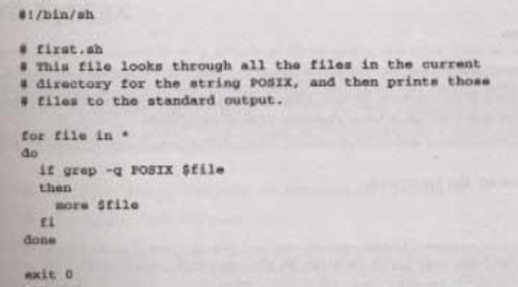
The command exit 0
Causes the script program to exit and return a value of 0, which means there were not errors.

Slide 38
Making a Script Executable
There are two ways to execute the script.
1) invoke the shell with the name of the script file as a parameter, thus:
/bin/sh first.sh (Or )
2) change the mode of the script to executable and then after execute it by just typing its name.
chmod +x first.sh first.sh
Actually, you may need to type:
./first.sh
to make the file execute unles the path variable has your directory in it.

Slide 39
Shell Metacharacters
1.
2.
3.
4.
5.
6.
File name substitution.
I/O Redirection.
Process execution.
Quoting Metacharacters.
Positional parameters.
Special characters.

Slide 40
F e name subs ution ?, *, .] ..
File name substitution ( ?, *, [..],[!..] )
These metacharacters are used to match the filenames in a directory.
?
◊ stands for any one character
* ◊ any combination of any number of characters.
[ ..] ◊ gives the shell a choice of any one character
from the enclosed list.
[!..] ◊ gives the shell a choice of any one character
except those enclosed in the list.

Slide 41
Examples
◊ list of all files beginning with character ‘a’.
$ ls a*
$ ls ??
◊ list of all those files whose
names are two
characters long.
$ls a?b? ◊ list of all files whose first
third character is ‘b’
character is ‘a’
and
$ls [c-z]*
◊the range of ‘c’ to ‘z’
$ls [!d-m]* ◊ list of all files whose
anything other than an alphabet
first character is
in the range ‘d’ to
‘m’.

Slide 42
I/O Red ection(>, <, >>)
I/O Redirection(>, <, >>)
M>&N → Merges the standard output and standard error if
m=1 and n=2.
Here m and n denote file descriptors. They can take the
values 0,1,2, representing standard input and
output and standard error respectively.
standard
Example
$ ls > myfile 2 > &1
o/p : consists
o/p of ls in file myfile.
The o/p of time is always sent on the standard
error.

Slide 43
Process execution ( ;,(),&,&&,|| )
; → To run more than one command in one
stroke.
() → To run commands in sub shell.
& → Runs the process in the background.
&& → To execute the second command if
the first succeeds.
|| → To carry out the second command if first fails.

Slide 44
Examples
$ ls;who;time
$ (cd mydir;pwd)
$sort abcd > abcd2 &
$grep “supplement” paper > newpaper
&& cat paper
$ grep “sachin” addresses || grep “sachin” adrfile &&
cat afile
What if the first grep is successful in || ?
The second command is skipped and the next command is executed.

Slide 45
Quoting
Metacharacters
(
\,”
“,
‘
‘,`
`
)
\
→ to remove shell dilemma, we \ before
Metacharacters.
any
`
` → Back quotes replace command with its o/p.
‘
‘ → To take every enclosed character literally.
“ “ → Allows to hold special status of Metacharacters.

Slide 46
EXAMPLES
$ echo Hello; Word
Hello
$ echo Hello\; Word
Hello; Word
The $ sign is one of the meta characters, so it must be quoted to avoid special handling by the shell
$ echo "I have \$1200"
I have $1200
Backslash tells shell to ignore next character.
$ echo $HOSTNAME
Mamatha-Mamatha
$ echo \$HOSTNAME
$HOSTNAME

Slide 47
1. Anything which is enclosed between single and double quote can be treated as single string.They are useful ,if you need to refer to a file that has spaces in its name.
$ touch “first script”
$ ls –l first script
No such file or directory
$ ls –l “first script”
-rw-r---r 1 mamatha mamatha ……..
2. Both suppress the meaning of wild-cards
$ echo *.c
ab.c anc.c ws.c f1.c f2.c
echo “*.c”
*.c
$ echo ‘*.c’
*.c

Slide 48
3. Command Substitution can be performed using double quotes i.e Back quote can be used within double quote
$ echo “Today date is `date`”
Today date is Fri Jan 7 18:22:22 IST 2018
$ echo ‘Today date is `date`’
Today date is `date`

Slide 49
4. The basic difference between single quote and double quote is that single quote does not perform any kind of substitution i.e that is what ever written inside single quote is simply a string whereas double quote allow substitution.
$ a=5
$ echo “value of a is $a”
5
$ echo ‘value of a is $a’
value of a is $a

Slide 50
EXAMPLES
# | Expression | Result | Comment
1 | "$a" | apple | variables are expanded inside ""
2 | '$a' | $a | variables are not expanded inside ''
3 | "'$a'" | 'apple' | '' has no special meaning inside "“
4 | '"$a"' | "$a" | "" is treated literally inside ''
5 | '\'' | **invalid** | can not escape a ' within ''; use "'" or $'\'' (ANSI-C quoting)
6 | "red$arocks"| red | $arocks does not expand $a; use ${a}rocks to preserve $a
7 | "redapple$" | redapple$ | $ followed by no variable name evaluates to $
8 | '\"' | \" | \ has no special meaning inside '‘
9 | "\'" | ' | \' is interpreted inside ""
10 | "\"" | " | \" is interpreted inside ""

Slide 51
EXAMPLES
$
$
$
$
echo
echo
echo
echo
this is
this is
‘$,\,?, “ your
a *
a \*
all just the way they name is $name”
look”
$
echo
today
is `date’

Slide 52
Shell Variables
Variables are generally created when you first use them.
By default, all variables are considered and stored as strings.
Variable names are case sensitive
No type declaration is necessary before u can use a shell variable.
Variables provide the ability to store and manipulate the information with in the shell program. The variables are completely under the control of user.

Slide 53
You can define and use variables both in the command line and shell scripts. These variables are called shell variables.
Generalized form:
variable=value
Eg:
$ x=10
$ echo $x
10
To remove a variable use unset.
$ unset x

Slide 54
All shell variables are initialized to null strings by default.
To explicitly set null values use
x= or x=‘’ or x=“”
To assign multiword strings to a variable use
$ msg=‘u have a mail’
To make variable global use export
Ex: $ echo $0 $ ksh
bash $ echo $0
$ x=10 ksh
$ echo &x $ echo &x
10 $ export x

Slide 55
Environment Variables
They are initialized when the shell script starts and normally capitalized to distinguish them from user-defined variables in scripts
Environmental variables control the user environment.
Environmental variables are set by the environment, the operating system, during the startup of your shell.
Environment variables are dynamic values which affect the processes or programs on a computer. They exist in every operating system, but types may vary.

Slide 56
Reading environment variables same as shell variables
For example :
An environment variable named HOME, you can access the value of this variable by using the dollar($) sign, for example $HOME
The environmental variables are in uppercase.

Slide 57
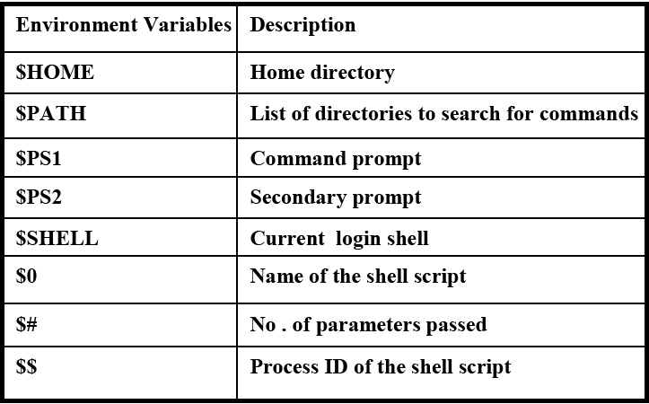

Slide 58
$# - Stores the number of command-line arguments that were passed to the shell program.
$? - Stores the exit value of the last command that was executed.
$* - Stores all the arguments that were entered on the command line ($1 $2 ...).
"$@" - Stores all the arguments that were entered on the command line, individually quoted ("$1" "$2" ...).

Slide 59
Example:
$ ./command -yes -no /home/username
$# = 3
$* = -yes -no /home/username
$@ = array: {"-yes", "-no", "/home/username"}

Slide 60
Command Substitution
When a Shell executes a command, the output is directed to standard output( most of the time, standard output is associated with monitor)
Shell allows the standard output of one command to be used as an argument of another command
Some times we need to change the output to a string that we can store in another string or a variable .
Command substitutions provides the capability to convert the result of a command to a string
Without command substitution
With command substitution
suma
‹#›

Slide 61

The command substitution operator that converts the output of a command to a string is a dollar sign and a set of parentheses.
Backquote ( ` ` )or backtick is another metacharacter that used for command substitution
When scanning the command line, the shell executes the enclosed command and replaces the enclosed command line with the out put of the command
command
Without command substitution
$(command)
string
With command substitution
suma
‹#›

Slide 62
You can use this feature to generate meaningful messages
Ex:
$ echo “ There are ` ls | wc –l ` file in the current directory”
There are 58 files in the current directory
$ echo The date Today is `date’
The date Today is Sat Jan 7 19:01:18 IST 2002
When the single quote is used:
$ echo ‘There are ` ls | wc –l ` file in the current directory’
There are `ls |wc –l ` files in the current directory

Slide 63
Shell Commands
The commands used inside the shell for programming tasks are known as the shell commands, those are:
expr command
The expr utility is used to evaluate arithmetic operations, as shell doesn’t support arithmetic operators.
Expression will be evaluated by expr utility and the result is sent to the standard output.
Special symbols such as *,>,< must be preceded by a \, otherwise the shell treats it as a meta-character and yields wrong results
Example: $ i = 10 ; j = 10
$ echo `expr $i + $j`
20
$ echo `expr $i \* $j`
100
‹#›

Slide 64
2) who | sort
who command displays who logged onto the system and provides an account of all users
It displays a three column output, the first column displays the user-ids of users currently working on the system.
The second column displays the system name.
The third column displays the date and time.
Sort command sorts text files. It sorts all the lines from the standard input.
who | sort before displaying the who output on the screen it is piped to sort.
Sort receives the output of who as standard input, it then sorts the output according to the first alphabet in each line and displays it on screen
‹#›

Slide 65


Slide 66
3) ls | wc –l
ls command lists all the files and directories on the standard output.
wc –l command counts the number of files it receives as standard input
ls command is piped to wc –l command where the standard output of ls is given as standard input to wc coomand.
Thus, it displays the count of files and directories on the standard output
suma
‹#›

Slide 67
4) break
Break statement causes the control to come out of the loop instantly.
It terminates the loop.
# break.sh
#!/bin/sh
x = 5
while[$x –gt 3] #outer while loop
do y = 5
while[$y –gt 2] #inner while loop
do
if[$y –eq 3]
then
break; #immediately terminates inner loop when y =3
else
echo $x $y
fi
y = ‘expr $y – 1’
done
x = expr $x – 1
done
suma
‹#›

Slide 68
tee command
The tee command copies standard input to standard output and at the same time copies it to one or more files.
If the stream is coming from another command, such as who, it can be piped to the tee command.
The tee command
tee file-list
Example:
$The following command (with the help of tee command) writes the output both to the screen (stdout) and to the file.
$ ls | tee file
Options
-a :append
suma
‹#›

Slide 69
By default tee command overwrites the file. You can instruct tee command to append to the file using the option –a as shown below.
$ ls | tee –a file
You can also write the output to multiple files as shown below.
$ ls | tee file1 file2 file3

Slide 70
6) Aliases
An alias provides a means of creating customized commands by assigning a name to a command.
An alias is created by using the alias command. Its format is
alias name=command-definition
Example :
Using alias to rename the list command
$ alias dir=ls
$ dir
alias of command with options
$alias dir=‘ls –l’
$ dir
Listing aliases Removing all aliases
$alias $unalias -a
Removing aliases
$alias dir
$unalias dir
suma
‹#›

Slide 71
7) eval command
The eval command is used when the Bourne shell needs to evaluate a command twice before executing it.
Example 1:
If we need to store the name of a variable in a second variable and then use the print command to display the value of the original variable. Example-2:
Wrong way to use a variable in a variable
$x=23
$y=x
$print $y
x
Another wrong way to use a variable in a variable
$x=23
$y=x
$print \$$y
$x
Correct way to use a variable in a variable
$ eval print \$$y
‹#›

Slide 72
Example-2: To execute that command stored in the string
/home/mamatha > a="ls | more“
/home/mamatha > $a
bash: command not found: ls | more
/home/user1 > # Above command didn't work as ls tried to list file with name pipe (|) and more. But these files are not there
/home/mamatha > eval $a
file.txt
mailids
remote_cmd.sh
sample.txt
Tmp
/home/mamatha >

Slide 73
Example-3:To print the value of variable which is again variable with value assigned to it
$ a=10
$ b=a
$ c='$'$b ( note: The dollar sign must be escaped with '$')
$ echo $c
output:
$a
$ eval c='$'$b
$ echo $c
output:
10

Slide 74
Quoting
Shell uses a selected set of metacharcters in commands.
Metacharcters are characters that have a special interpretation.
For example the pipe (|)
In order to use them as a normal text we must tell the shell interpreter that they should be interpreted differently. This is called quoting the metacharcters.
To achieve quoting there are three metacharcters collectively as quotes,
Quotes
Backslash
Double Quotes
Single Quotes
‹#›

Slide 75
Backslash
The backslash metacharcter (\) is used to change the interpretation of the character that follows it, i.e., it converts a literal character into a special character and vice versa.
Example:
The character n is interpreted as a literal character by the shell to change its interpretation as a newline character we use backslash before it (\n).
Similarly the use of a greater than symbol (>) in a command is interpreted as a special character (output redirection), to change its interpretation as a literal text we use a backslash before it (\>)
$echo My name is - \> Ramesh\n
My name is ->Ramesh
‹#›

Slide 76
Double Quotes
Double quotes (“) are used to change the meaning of several characters.
They change the special interpretation of most metacharcters like <,>,?,& and so on.
These metacharcters are treated as literal characters.
Example:
$ echo “Metacharcters are : >,<,?,|,&“
Metacharcters are : >,<,?,|,&
Double quotes cannot remove the special interpretation of a dollar sign in front of a variable and single quotes.
$ echo a = 10
$ echo “a is $a and single quote is ‘b’ “
a is 10 and single quote is ‘b’
‹#›

Slide 77
Single Quotes
Like double quotes, single quotes change the special interpretation of metacharcters.
It not only treats metacharcters like >,<,?,$ and so on as literals but also the metacharcters dollar sign ($) and every double quotes.
Example:
$ echo a = 10
$ echo ‘characters are < > “b” $a ? &’
characters are < > “b” $a ? &
‹#›

Slide 78
Control Structures
Control structures alter the flow of the program
Control Structures are:
if-then-else
case
loops
for
while
Until
4.Handling signals
‹#›

Slide 79
THE SIMPLE IF STATEMENT
SYNTAX:
if [ condition ]; then
statements
Fi
Executes the statements only if condition is true
Ex:
#!/bin/bash
# Basic if statement
if [ $1 -gt 100 ]
then
echo Hey that\'s a large number.
pwd
fi
Date
‹#›

Slide 80
Output: ./ if_example.sh 15
Sat 6 Jan 5:06:35 2018
$ ./if_example.sh 150
· Hey that's a large number.
· /home/ryan/bin
· Sat 6 Jan 5:06:35 2018

Slide 81
THE IF-THEN-ELSE STATEMENT
if [ condition ]; then
statements-1
else
statements-2
fi
executes statements-1 if condition is true
executes statements-2 if condition is false
‹#›

Slide 82
THE NESTED IF
if [ condition ]; then
statements
elif [ condition ]; then
statement
else
statements
fi
The word elif stands for “else if”
It is part of the if statement and cannot be used by itself
‹#›

Slide 83
primary | Meaning
[ -a FILE ] | True if FILE exists.
[ -b FILE ] | True if FILE exists and is a block-special file.
[ -c FILE ] | True if FILE exists and is a character-special file.
[ -d FILE ] | True if FILE exists and is a directory.
[ -e FILE ] | True if FILE exists.
[ -f FILE ] | True if FILE exists and is a regular file.
[ -g FILE ] | True if FILE exists and its SGID bit is set.
[ -h FILE ] | True if FILE exists and is a symbolic link.
[ -k FILE ] | True if FILE exists and its sticky bit is set.
[ -p FILE ] | True if FILE exists and is a named pipe (FIFO).

Slide 84
[ -r FILE ] | True if FILE exists and is readable.
[ -s FILE ] | True if FILE exists and has a size greater than zero.
[ -t FD ] | True if file descriptor FD is open and refers to a terminal.
[ -u FILE ] | True if FILE exists and its SUID (set user ID) bit is set.
[ -w FILE ] | True if FILE exists and is writable.
[ -x FILE ] | True if FILE exists and is executable.
[ -O FILE ] | True if FILE exists and is owned by the effective user ID.
[ -G FILE ] | True if FILE exists and is owned by the effective group ID.
[ -L FILE ] | True if FILE exists and is a symbolic link.
[ -N FILE ] | True if FILE exists and has been modified since it was last read.
[ -S FILE ] | True if FILE exists and is a socket.

Slide 85
[ FILE1 -nt FILE2 ] | True if FILE1 has been changed more recently than FILE2, or if FILE1 exists and FILE2 does not.
[ FILE1 -ot FILE2 ] | True if FILE1 is older than FILE2, or is FILE2 exists and FILE1 does not.
[ FILE1 -ef FILE2 ] | True if FILE1 and FILE2 refer to the same device and inode numbers.
[ -o OPTIONNAME ] | True if shell option "OPTIONNAME" is enabled.
[ -z STRING ] | True of the length if "STRING" is zero.
[ -n STRING ] or [ STRING ] | True if the length of "STRING" is non-zero.
[ STRING1 == STRING2 ] | True if the strings are equal. "=" may be used instead of "==" for strict POSIX compliance.

Slide 86
[ STRING1 != STRING2 ] | True if the strings are not equal.
[ STRING1 < STRING2 ] | True if "STRING1" sorts before "STRING2" lexicographically in the current locale.
[ STRING1 > STRING2 ] | True if "STRING1" sorts after "STRING2" lexicographically in the current locale.
[ ARG1 OP ARG2 ] | "OP" is one of -eq, -ne, -lt, -le, -gt or -ge. These arithmetic binary operators return true if "ARG1" is equal to, not equal to, less than, less than or equal to, greater than, or greater than or equal to "ARG2", respectively. "ARG1" and "ARG2" are integers.

Slide 87
Combining expressions
Operation | Effect
[ ! EXPR ] | True if EXPR is false.
[ ( EXPR ) ] | Returns the value of EXPR. This may be used to override the normal precedence of operators.
[ EXPR1 -a EXPR2 ] | True if both EXPR1 and EXPR2 are true.
[ EXPR1 -o EXPR2 ] | True if either EXPR1 or EXPR2 is true.

Slide 88
THE CASE STATEMENT
use the case statement for a decision that is based on multiple choices
Syntax:
case word in
pattern1) command-list1
;;
pattern2) command-list2
;;
patternN) command-listN
;;
esac
case pattern
checked against word for match
may also contain:
*
?
[ … ]
[:class:]
multiple patterns can be listed via:
|
suma
‹#›

Slide 89
THE WHILE LOOP
Purpose:
To execute commands in “command-list” as long as “expression” evaluates to true
Syntax:
while [ expression ]
do
command-list
done
suma
‹#›

Slide 90
THE UNTIL LOOP
Purpose:
To execute commands in “command-list” as long as “expression” evaluates to false
Syntax:
until [ expression ]
do
command-list
done
suma
‹#›

Slide 91
The while loop vs the until loop
The until loop executes until a nonzero status is returned.
The while command executes until a zero status is returned.
The until loop always executes at least once
Example
Create a shell script called f1.sh:
#!/bin/bash
i=1
until [ $i -gt 6 ]
do

Slide 92
echo "Welcome $i times."
i=$(( i+1 ))
done
save and close the file. Run it as follows:
$ chmod +x until.sh
$ ./until.sh
outputs:
Welcome 1 times.
Welcome 2 times.
Welcome 3 times.
Welcome 4 times.
Welcome 5 times.
Welcome 6 times.

Slide 93
THE FOR LOOP
Purpose:
To execute commands as many times as the number of words in the “argument-list”
Syntax:
for variable in argument-list
do
commands
done
suma
‹#›

Slide 94
Example :
#!/bin/sh
for var in 0 1 2 3 4 5 6 7 8 9
Do
echo $var
Done
Upon execution, you will receive the following result −
0
1
2
3
4
5
6
7
8
9

Slide 95
Handling signals
Unix allows you to send a signal to any process
-1 = hangup kill -HUP 1234
-2 = interrupt with ^C kill -2 1235
no argument = terminate kill 1235
-9 = kill kill -9 1236
-9 cannot be blocked
list your processes with
ps -u userid
suma
‹#›

Slide 96
Number | SIG | Meaning
0 | 0 | On exit from shell
1 | SIGHUP | Clean tidyup
2 | SIGINT | Interrupt
3 | SIGQUIT | Quit
6 | SIGABRT | Abort
9 | SIGKILL | Die Now (cannot be trapped)
14 | SIGALRM | Alarm Clock
15 | SIGTERM | Terminate

Slide 97
Signals on Linux
% kill -l
1) SIGHUP 2) SIGINT 3) SIGQUIT 4) SIGILL
5) SIGTRAP 6) SIGABRT 7) SIGBUS 8) SIGFPE
9) SIGKILL 10) SIGUSR1 11) SIGSEGV 12) SIGUSR2
13) SIGPIPE 14) SIGALRM 15) SIGTERM 16) SIGSTKFLT
17) SIGCHLD 18) SIGCONT 19) SIGSTOP 20) SIGTSTP
21) SIGTTIN 22) SIGTTOU 23) SIGURG 24) SIGXCPU
25) SIGXFSZ 26) SIGVTALRM 27) SIGPROF 28) SIGWINCH
29) SIGIO 30) SIGPWR 31) SIGSYS 34) SIGRTMIN
35) SIGRTMIN+1 36) SIGRTMIN+2 37) SIGRTMIN+3 38) SIGRTMIN+4
39) SIGRTMIN+5 40) SIGRTMIN+6 41) SIGRTMIN+7 42) SIGRTMIN+8
43) SIGRTMIN+9 44) SIGRTMIN+10 45) SIGRTMIN+11 46) SIGRTMIN+12
47) SIGRTMIN+13 48) SIGRTMIN+14 49) SIGRTMIN+15 50) SIGRTMAX-14
51) SIGRTMAX-13 52) SIGRTMAX-12 53) SIGRTMAX-11 54) SIGRTMAX-10
55) SIGRTMAX-9 56) SIGRTMAX-8 57) SIGRTMAX-7 58) SIGRTMAX-6
59) SIGRTMAX-5 60) SIGRTMAX-4 61) SIGRTMAX-3 62) SIGRTMAX-2
63) SIGRTMAX-1 64) SIGRTMAX
^C is 2 - SIGINT
suma
‹#›

Slide 98
Handling signals
Default action for most signals is to end process
term: signal handler
Bash allows to install custom signal handler
When you press the Ctrl+C or Break key at your terminal during execution of a shell program, normally that program is immediately terminated, and your command prompt returns. This may not always be desirable. For instance, you may end up leaving a bunch of temporary files that won't get cleaned up.
Syntax:
trap 'handler commands' signals
suma
‹#›

Slide 99
Example:
trap 'echo do not hangup' 1 2
Two common uses for trap in shell scripts
Clean up temporary files
Ex: $ trap "rm -f $WORKDIR/f1 WORKDIR/f2; exit" 2
Ignore signals
Ex: $ trap '' 2

Slide 100
Arithmetic in Shell
Shell Arithmetic
Use to perform arithmetic operations.
Syntax: expr op1 math-operator op2
Examples: $ expr 1 + 3 $ expr 2 - 1 $ expr 10 / 2 $ expr 20 % 3 $ expr 10 \* 3 $ echo `expr 6 + 3`
Note: expr 20 %3 - Remainder read as 20 mod 3 and remainder is 2. expr 10 \* 3 - Multiplication use \* and not * since its wild card.
suma
‹#›

Slide 101
Shell Arithmetic
For the last statement note the following points.
(1) First, before expr keyword we used ` (back quote) sign not the (single quote i.e. ') sign. Back quote is generally found on the key under tilde (~) on PC keyboard OR to the above of TAB key.
(2) Second, expr is also end with ` i.e. back quote.
(3) Here expr 6 + 3 is evaluated to 9, then echo command prints 9 as sum
(4) Here if you use double quote or single quote, it will NOT work
For e.g. $ echo "expr 6 + 3" # It will print expr 6 + 3 $ echo 'expr 6 + 3' # It will print expr 6 + 3
suma
‹#›

Slide 102
TEST COMMAND
Checks file types and compares values.
test is used as part of the conditional execution of shell commands.
test exits with the status determined by EXPRESSION. Placing the EXPRESSION between square brackets ([ and ]) is the same as testing the EXPRESSION with test.
To see the exit status at the command prompt, echo the value "$?" A value of 0 means the expression evaluated as true, and a value of 1 means the expression evaluated as false.

Slide 103
Syntax:
test EXPRESSION
(or)
[ EXPRESSION ]
Examples:
test 100 -gt 99 && echo "Yes, that's true." || echo "No, that's false."
This command will print the text "Yes, that's true." because 100 is greater than 99.
test 100 -lt 99 && echo "Yes." || echo "No.“
This command will print the text "No." because 100 is not less than 99.

Slide 104
[ "awesome" = "awesome" ];
echo $?
This command will print "0" because the expression is true; the two strings are identical.
[ 5 -eq 6 ];
echo $?
This command will print "1" because the expression is false; 5 does not equal 6.

Slide 105
Comparing Numbers:
If you are comparing elements that parse as numbers you can use the following comparison operators:
-eq - does value 1 equal value 2
-ge - is value 1 greater or equal to value 2
-gt - is value 1 greater than value 2
-le - is value 1 less than or equal to value 2
-lt - is value 1 less than value 2
-ne - does value 1 not equal value 2

Slide 106
Comparing Text:
If you are comparing elements that parse as strings you can use the following comparison operators:
= - does string 1 match string 2
!= - is string 1 different to string 2
-n - is the string length greater than 0
-z - is the string length 0
Examples:
test "string1" = "string2" && echo "yes" || echo "no"
(displays "no" to the screen because "string1" does not equal "string2")

Slide 107
Functions
A shell function is similar to a shell script
stores a series of commands for execution later
shell stores functions in memory
shell executes a shell function in the same shell that called it
Where to define
In .profile
In your script
Or on the command line
Remove a function
Use unset built-in
suma
‹#›

Slide 108
must be defined before they can be referenced
usually placed at the beginning of the script
Syntax:
function-name () {
statements
}
suma
‹#›

Slide 109
Function parameters
Need not be declared
Arguments provided via function call are accessible inside function as $1, $2, $3, …
$# reflects number of parameters
$0 still contains name of script
(not name of function)
suma
‹#›

Slide 110
Local Variables in Functions
Variables defined within functions are global, i.e. their values are known throughout the entire shell program
Keyword “local” inside a function definition makes referenced variables “local” to that function
suma
‹#›

Slide 111
#!/bin/sh
# Define your function here
Hello ()
{ echo "Hello World $1 $2“
return 10 }
# Invoke your function
Hello Zara Ali
# Capture value returnd by last command
ret=$?
echo "Return value is $ret"
Output:
$./test.sh
Hello World Zara Ali
Return value is 10

Slide 112
#!/bin/sh
myfunc()
{
echo "I was called as : $@“
x=2 }
### Main script starts here
echo "Script was called with $@"
x=1
echo "x is $x" Output:
myfunc 1 2 3 $ scope.sh a b c
echo "x is $x” Script was called with a b c
x is 1
I was called as : 1 2 3
x is 2

Slide 113
Debugging Shell Scripts
Debugging is troubleshooting errors that may occur during the execution of a program/script
The following two commands can help you debug a bash shell script:
echo
use explicit output statements to trace execution
set
suma
‹#›

Slide 114
Debugging using “set”
The “set” command is a shell built-in command
has options to allow flow of execution
–v option prints each line as it is read
–x option displays the command and its arguments
–n checks for syntax errors
options can turned on or off
To turn on the option: set -xv
To turn off the options: set +xv
Options can also be set via she-bang line
#! /bin/bash -xv
suma
‹#›

Slide 115
(or)
x option to debug a shell script
Run a shell script with -x option. $ bash -x script-name $ bash -x domains.sh
(or)
The -x option, short for xtrace or execution trace, tells the shell to echo each command after performing the substitution steps Thus , we can see the values of variables and commands. Often, this option alone will help to diagnose a problem.

Slide 116
Ex:
We can use set –x command in shell script itself:
#!/bin/bash
clear
# turn on debug mode
set –x
for f in *
do
file $f
done
# turn OFF debug mode
set +x
ls # more commands

Slide 117
The -v option tells the shell to run in verbose mode. In practice , this means that shell will echo each command prior to execute the command. This is very useful in that it can often help to find the errors.
Ex:
snist:~/mamta> set –v
snist:~/mamta> ls
ls
commented-scripts.sh script1.sh
snist:~/mamta> set +v
set +v
snist:~/mamta> ls *
commented-scripts.sh script1.sh

Slide 118
The -n option, shot for noexec ( as in no execution), tells the shell to not run the commands. Instead, the shell just checks for syntax errors. This option will not convince the shell to perform any more checks. Instead the shell just performs the normal syntax check. With -n option, the shell doesn’t execute your commands, so you have a safe way to test your scripts if they contain syntax erro
Ex: shell script name debug_quotes.sh
#!/bin/bash
echo "USER=$USER
echo "HOME=$HOME"
echo "OSNAME=$OSNAME"
Now run the script with -n option
$ sh -n debug_quotes
debug_quotes: 8: debug_quotes: Syntax error: Unterminated quoted string.

Slide 119
We can use the debug function for debugging specific statement in the shell script. An example is shown below:
#!/bin/bash
_DEBUG="on“
function DEBUG()
{ [ "$_DEBUG" == "on" ] && $@
}
DEBUG echo 'Printing Numbers'
for i in `seq 1 3`
do
echo $i done
Running the script: $ bash script.sh 1 2 3 $ export _DEBUG=on Printing Numbers 1 2 3

Slide 120
Thank
you

